Slide 1
Supplier Document Standardisation Automation Using Power Automate
Jack

Slide 2
Business Problem
Supplier documents lacked consistent company branding
Manual updates required for titles and company stamping
High risk of formatting inconsistency and non-compliance
Time-consuming manual processing for each document

Slide 3
Solution Overview
Built file-triggered automation on SharePoint folder
Automatically standardised document titles to company format
Applied electronic company stamp to document footer
Ensured consistent branding across all supplier documents
Eliminated manual formatting and document handling effort
Implemented failure & timeout alerts to maintenance team

Slide 4
Business Impact
estimated process effort for supplier document standardisation automation
≈ 85–95% less effort
Time saved
~9 mins
per document
Eliminated manual renaming and stamping effort
Ensured 100% consistency in document branding
Reduced risk of non-compliance with corporate standards
Improved document processing speed and efficiency
Established a consistent and scalable document governance process
Estimates based on typical process time per document.

Slide 5
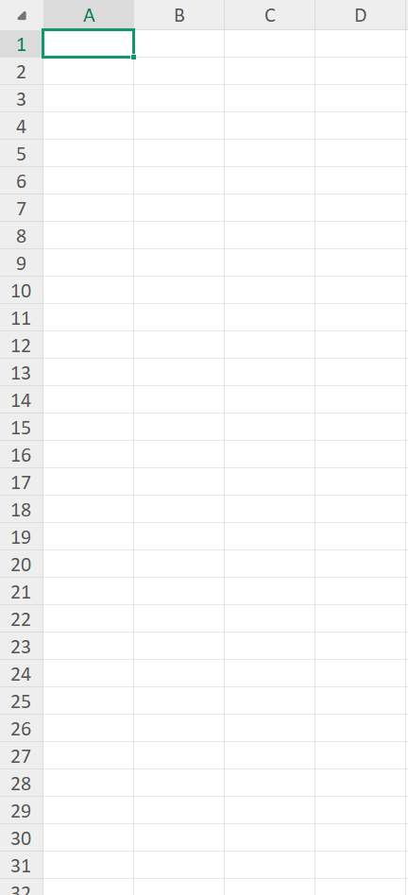
Automated Document Standardisation
Manual Document
Standardised Document
Supplier’s Title
Company’s Title
Content
Content
Company’s stamp
(Footer)
Illustrative example shown due to data privacy considerations.

Slide 6
Flow - Standardisation Automation
Supplier Document Standardisation Automation
Trigger: New supplier document uploaded in selected folder
Standardise document title to company format
Replace Document’s Header/Title by Company’s Header/Title
Insert electronic company stamp in footer
Save updated and compliant version

Slide 7







Trigger When New File is Added (Onedrive Folder)
Scope - Try
Get File Content (Company Standard Title & Electronic Company Stamp)
Apply to Each - New File
Get File Content
Replace Document’s Header/Title by
Company’s Header/Title
Insert Electronic Company Stamp at Document Footer
Save Updated Version of the Document
Scope - Catch
Capture Error Details
Update Status
→ Failed
Send Failure Email
(Maintenance)
Workflow diagram recreated for illustration purposes (original system data is confidential).
Scope - Finally
Write Audit Log

